Slide 1
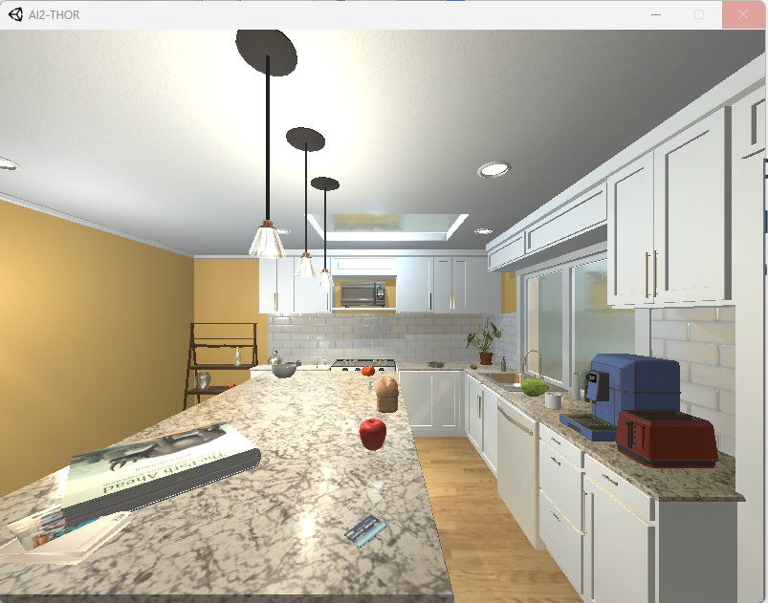
Thor-Soar Agent
John Laird Center for Integrated Cognition
https://integratedcognition.ai May 5, 2025
Lots of help from
Nathan Glenn and James Beyer
and rest of CIC

Slide 2
Thor-Soar Goals
Create Reference Embodied Soar Agent
Environmental interaction: sensing, motor
Representations: goals, world, objects, relations, …
Operators: proposals & application
General problem and planning
Grounding for goal specifications and interaction
2. Platform for Agent Research
Language integration
What is the target representation for language?
Interactive Task Learning
What knowledge (content and structure) needs to be learned?

Slide 3
Agent Design Goals
Flexible task/goal specification
Can be created from natural language interaction
Minimal task preparation
Exhaustive RL is a non-starter
Efficient problem solving
Brute-force forward search is a non-starter
Efficient execution
Faster than real time
Support multiple levels of world, task, & search-control knowledge

Slide 4
Initial Kitchen Environment for Thor-Soar
Objects (75+)
apple, bottle, bread, counter tops, cabinets, credit card, egg, dishwasher, drawers, floor, faucet, houseplant, light switch, lettuce, knife, kettle, microwave, paper towel roll, pan mug, pot, potato, plate, peppershaker, spatula, spoon, soap bottle, stove burner, stools, statues, sink, shelving units, tomato, toaster, vase, wine bottle, windows
Physical Actions (~14)
Approach, break-object, close-container, cook, empty-object, fill-object, get-object, look, open-container, put-in, put-on, slice-object, turn, turn-off, turn-on, …

Slide 5
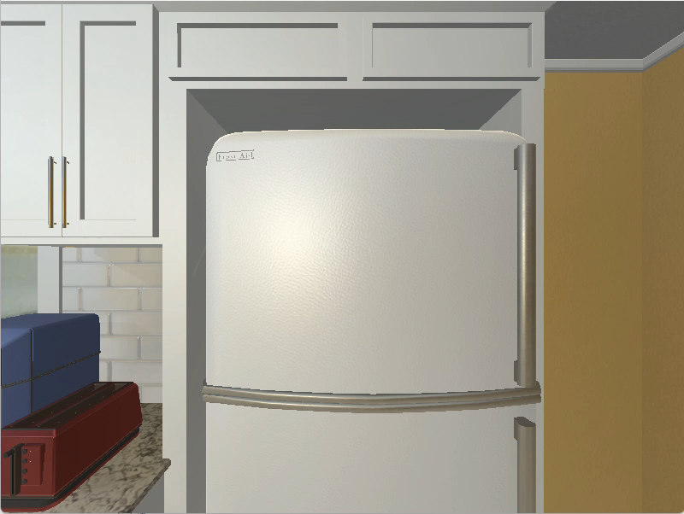
the bread is toasted; toasted slice is on a plate and the plate is on counter

Slide 6
World Representation Conventions
^scene = all objects and relations in the current room. [~70]
Perceived
No longer perceived
Recalled from semantic and episodic memory
^world = attended objects [~5-10]
Objects and relations relevant to current goals and actions.
Makes planning and reasoning more efficient.
attend
reasoning and planning
^scene
^world

Slide 7
Agent decision making, planning, and learning >800 rules (sans NL)
Means-ends analysis: GPS (1959) / Prodigy (1991)
General search control: Priority ordering of relations & properties
(object position > robot location)
Look-ahead search via iterative deepening
Convert search to control knowledge via chunking

Slide 8

Put the potato into the fridge and close the door
Actions:
Open Fridge36
Approach Potato50
Pickup Potato50
Approach Fridge36
Put-in Fridge36
Close Fridge36

Slide 9
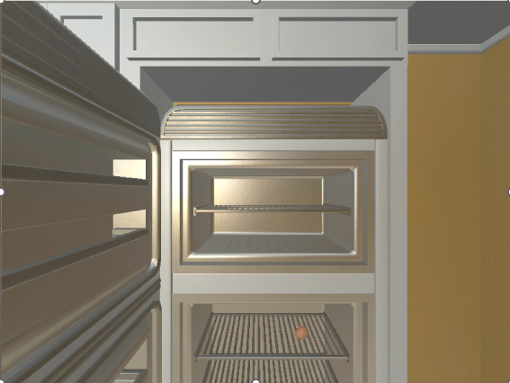
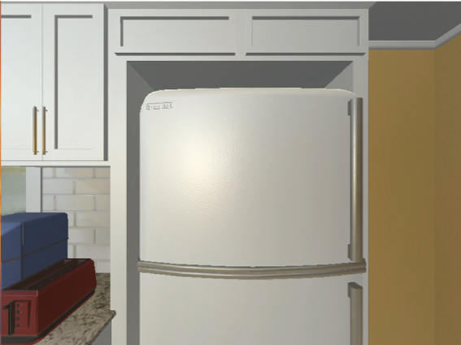
Means-ends Analysis
Goal:(in Potato50 Fridge30) (Fridge36 closed)
1. O: O130 (put-in Potato50 Fridge36)
2. ==>S: S7 (operator no-change)
3. O: O132 (open-container Fridge36)
Apply open-container
put-in proposal:
(in <obj1> <obj2>)
(in Potato50 Fridge30)
(open <obj2>)
(holding <obj1>)
(reachable <obj2>)
open-container proposal:
(open <objx>)
(holding none)
(reachable <objx>)
(off <objx>)
open apply

Slide 10
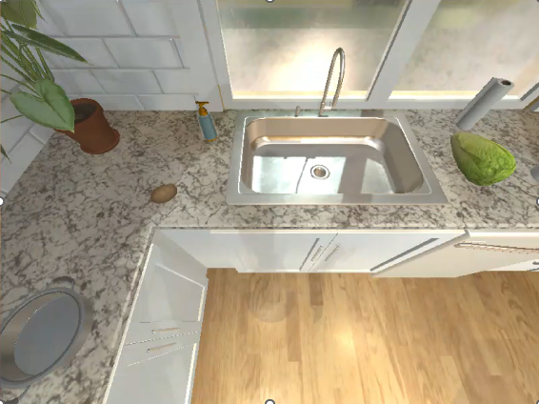
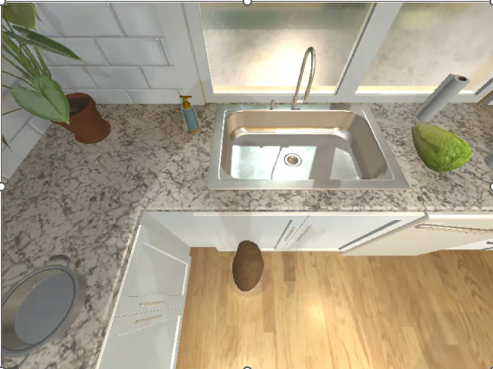
Means-ends Analysis
Desireds: (in Potato50 Fridge30) (Fridge36 closed)
1. O: O130 (put-in Potato50 Fridge36)
2. ==>S: S7 (operator no-change)
3. O: O132 (open-container Fridge36)
Apply open-container
4. O: O138 (get-object Potato50)
5. ==>S: S10 (operator no-change)
6. O: O139 (approach Potato50)
Apply approach Potato50
Apply get-object Potato50
put-in proposal:
(in <obj1> <obj2>)
(in Potato50 Fridge30)
(reachable <obj2>)
(open <obj2>)
(holding <obj1>)
(reachable <obj2>)
get-object proposal:
(holding <objy>)
(holding none)
(reachable <objy>)
(accessible <objy>)
(reachable <objy>)
approach proposal:
(reachable <objz>
get-object apply
(mobile self)
Approach apply

Slide 11
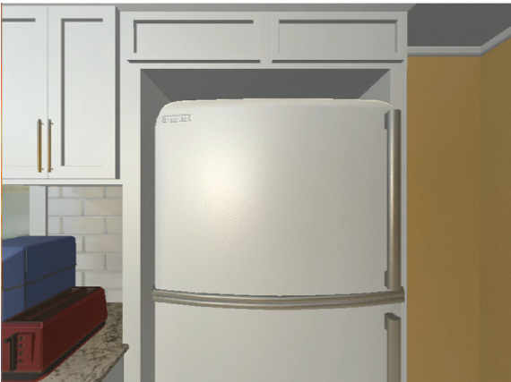
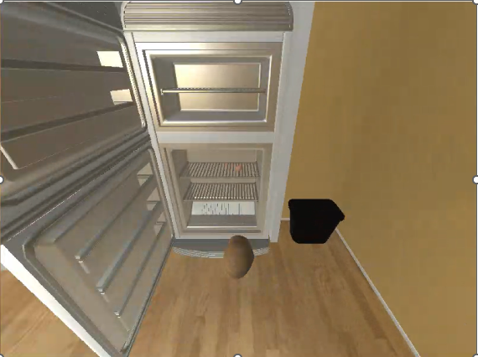
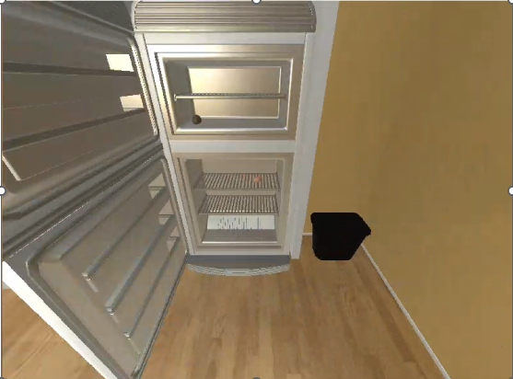
Means-ends Analysis
Desireds: (in Potato50 Fridge30) (Fridge36 closed)
1. O: O130 (put-in Potato50 Fridge36)
2. ==>S: S7 (operator no-change)
3. O: O132 (open-container Fridge36)
Apply open-container
4. O: O138 (get-object Potato50)
5. ==>S: S10 (operator no-change)
6. O: O139 (approach Potato50)
Apply approach Potato50
Apply get-object Potato50
7. O: O142 (approach Fridge36)
Apply approach Fridge36
Apply put-in Potato50 Fridge36
8. O: O144 (close-container Fridge36)
Apply close-container Fridge36
put-in proposal:
(in <obj1> <obj2>)
(in Potato50 Fridge30)
(Fridge36 closed)
(reachable <obj2>)
(open <obj2>)
(holding <obj1>)
(reachable <obj2>)
approach proposal:
(reachable <objz>
put-in apply
(mobile self)
Approach apply

Slide 12
Internal Search: Iterative Deepening
When search control knowledge is insufficient, must search
Multiple concurrent goals
Multiple actions that achieve a goal
Multiple objects that achieve a goal
Iterative deepening:
Iteratively increase the depth of a depth-bounded depth-first search
Compatible with means-ends analysis

Slide 13
Iterative Deepening
“make coffee” and “cook the potato” (unordered)
The solution is at least 11 steps: 681 decisions
But the only choice is which to select to do first
(In Thor-Soar, cooking a potato takes longer than making coffee.)

Slide 14

Iterative Deepening Impasses
Change each depth from # of operators to # of impasses
Don’t stop until you hit an impasse
185 decisions
vs. 681
64 after chunking

Slide 15
Goal Specifications
A set of partial state descriptions of object properties and relations (desireds)
Can specify conjunctions, disjunctions, and temporal orderings
NL parser translates action specifications into state descriptions
Put the apple in the fridge -> the apple is in the fridge.
Make coffee in the mug -> the mug is full of coffee
Allows the agent to figure out the best way to achieve the goal given its affordances
Issues about allowing human control over the method?
Attempts to ground to an existing specific object in the world
Unique ^object-handle for every object
(<d> ^desired.object <object>)
(<object> ^object-handle Fridge30
^open false)

Slide 16
Grounding Fun
Want to use properties and relations to designate an object.
The green apple on the nearby counter should be cooked.
An object might not currently be sensed
The apple that is in the fridge should be cooked.
The original object is transformed to new objects with new affordances
Don’t know what the identity of slices will be until the bread is slice
Put a slice of toasted bread on the plate.
Unspecified objects embedded in the operator applications.
To slice an object, must be holding a knife.
What knife?

Slide 17
Grounding: General Approach
Create an ungrounded description of the object [Aaron Mininger thesis]
Create a unique hypothetical object-handle
Include that hypothetical object-handle in the goal description
Hold the apple in the refrigerator
(<desc> ^in <in>)
(<in> ^argument1 <arg1> #apple
^argument2 <arg2>) #fridge
(<arg1> ^ungrounded true
^object-handle x-apple-234) # not known because in fridge
(<arg2> ^grounded true
^object-handle Fridge50)
(<desired> ^holding.object-handle x-apple-234)

Slide 18
Find-object Operator
Find-object proposal:
an unground object used in a goal structure
Find-object precondition:
an object satisfies the description of that unground object
becomes a goal
Find-object action:
replaces the hypothetical object-handle in the goal structure
(<object> ^object-handle x-apple-234 -
Apple3)

Slide 19
Knowledge Operators
Search for an object that satisfies the description
Ground-to-scene-object
An object in the scene matches the description
Search-semantic-memory
Query Smem to find a known object that matches the description
Search SVS
Search episodic memory
Lots of promise!
Explore-the-world
Open cupboards, go to other rooms, …
Ask a human
MEA and iterative deepening can direct the search

Slide 20
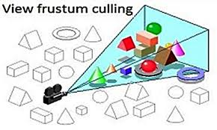
Remove Omniscient Sensing: Mostly Implemented
Limit sensing to a viewing frustum
Scan area and explore
Explore containers and remember contents
Store object information in semantic memory
Recall when re-entering room
Learn affordances through experimentation
Openable, grabbable, fillable, cleanable
Not breaking, slicing, or cooking!
Associate with object category and store in semantic memory

Slide 21


Defines agent conventions
General and efficient problem solving, search, and execution
Integrates MEA and iterative deepening and chunking
Initial integration with language
Still many rough edges
Some overly specific search control
Some chunking issues
Some grounding issues
Need to exploit episodic memory
Need to create a domain-independent version of the code: new default
Have applied to Blocks World
Issues with intertwined MEA subgoals

Slide 22

Real time with Soar Debugger (to slow it down a bit).

Slide 23
Goal Specification Flexibility: Dynamic Grounding
Initially assume goal specification was grounded to a specific object in the world.
Unique object-handle for every object and in included in goal
(in Potato50 Fridge30) (Fridg36 closed)
Distinguish two different specifications
Desired object properties/relations to be achieved:
The potato should be in the fridge.
Properties/relations that determine the desired object in the original situation.
Get the apple that is in the fridge. - That apple might never have been seen.
Tie together descriptions with an invented object-handle and label object description as ungrounded
Assume ultimately have to ground a specification of an object to a specific object.
Distinction between properties of the desired object (cooked, etc.) and properties of the object as it exists in the world (location, …).
Specify properties, not an id of desired.
Category, …
Get the egg that is in the refrigerator: get-egg-in-fridge
Handle objects that are destroyed and change id
Slicing, breaking
What object it will have been derived from
Internal desired object specification
Need to find a place to put down an object
Need to find an object with certain properties

Slide 24
Agent Development: ~820 rules
Initially assume lots of knowledge: omniscient sensing, object affordances, actions
Agent decision making and planning
Means-ends analysis
Select operator that achieves a desired
Unachieved preconditions become new desired
Not just task operators (knowledge operators)
Control knowledge
Difference priority (in = on > open = closed = accessible > holding > reachable > activated)
Precondition preference: Get X: holding none > accessible X > reachable X
Iterative deepening look-ahead search:
Shortest execution time
Intermixes actions with different durations
Chunking
Learns selection knowledge
Learns direct execution (some issues)
No extensive cumulative chunking experiments
No reinforcement learning or episodic memory use cases yet

